Slide 1


U 5
what’s the weather like?

Slide 2
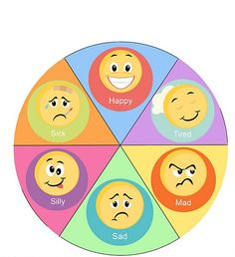

Slide 3


Objectives:
Compare weather around the world
Talk about seasons

Slide 4
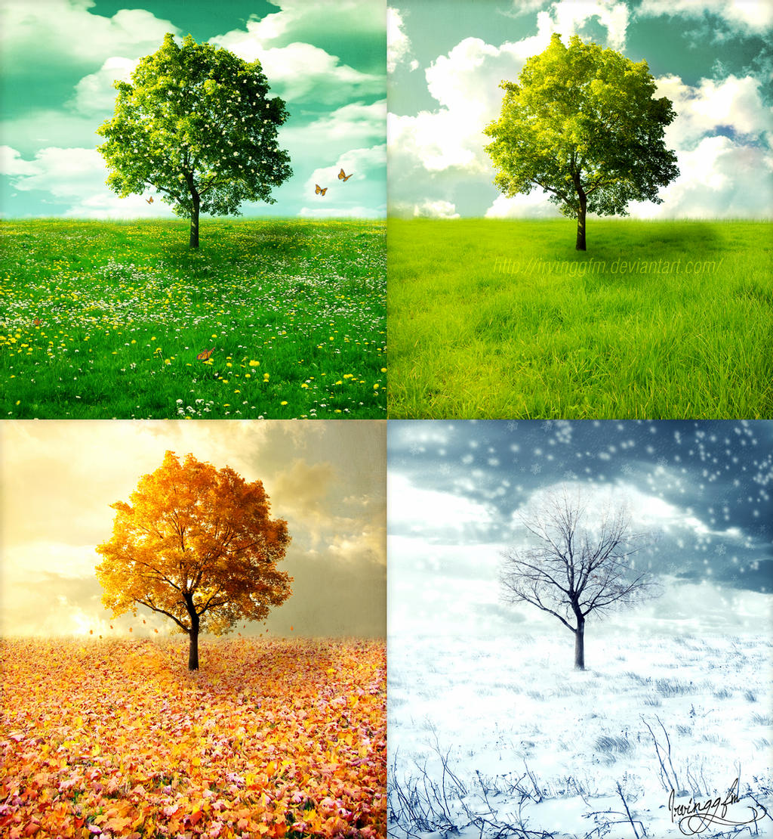
June 21 to September 21
Name the four seasons
March 21 to June 20
December 21 to March 20
September 22 to December 20

Slide 5
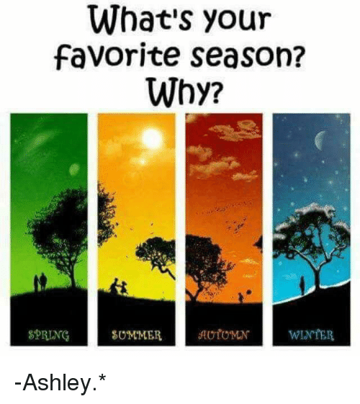

Slide 6
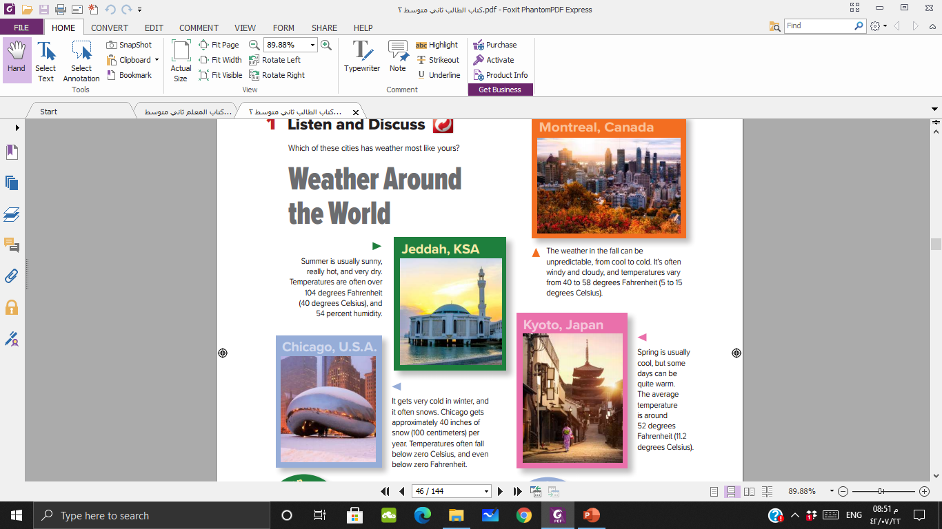
Where does it look hot?
What can people do in summer?
Where does it look cold?
Does it look humid or dry there?
What do you think the temperature is there?
What can people do in winter?

Slide 7
What time of the year is in Montreal?
What’s the weather like there?
What time of year are there beautiful cherry blossoms in Japan?
What’s the weather like?

Slide 8
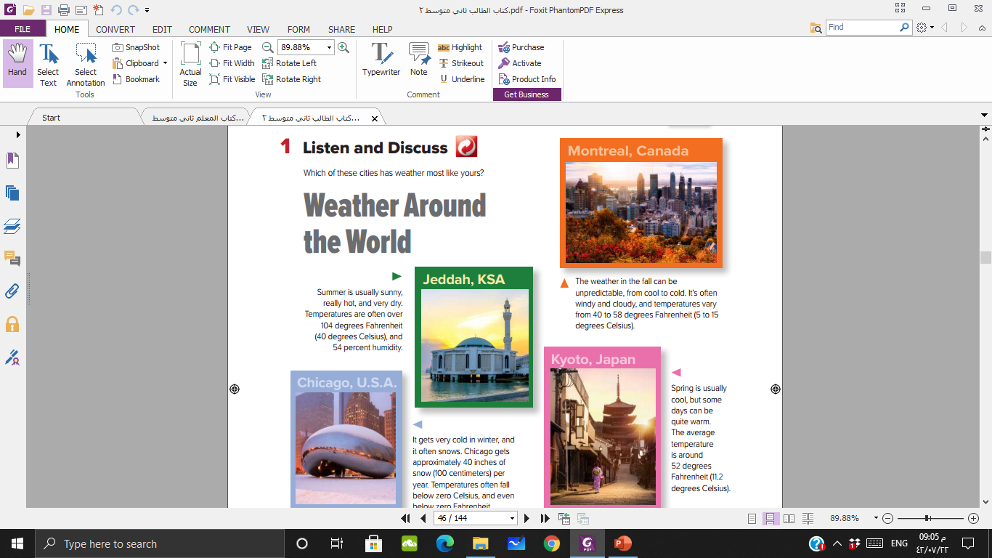


Slide 9
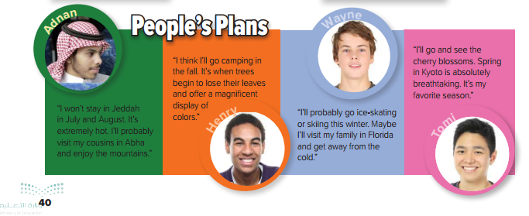
Where is ……….. from?

Slide 10
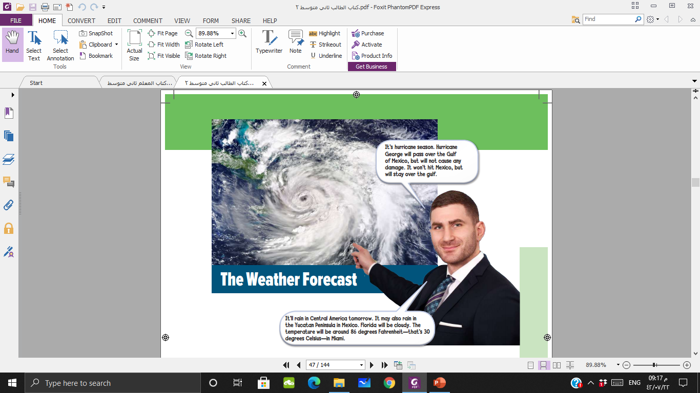
Who’s this?
A weather man
What is he pointing at?
Where is the
weather going to be cloudy?
What part
of the world is he going to talk about??
Florida
Central America

Slide 11
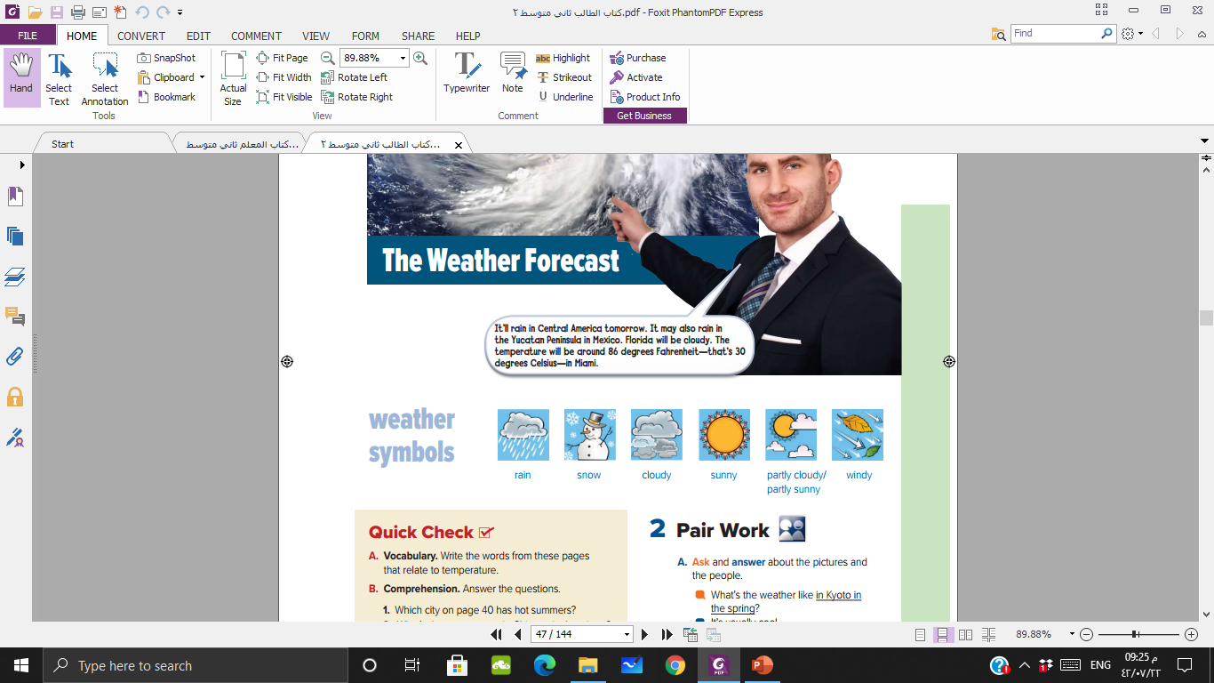
Are these weather words about temperature?
No

Slide 12
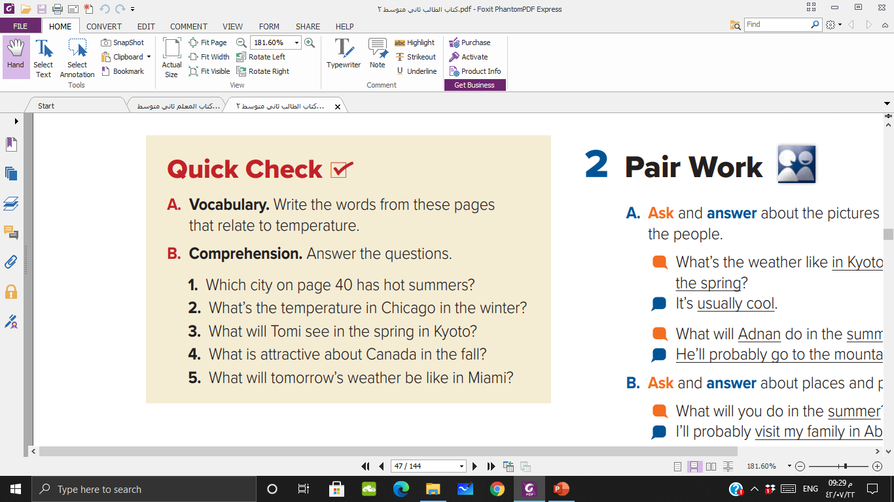
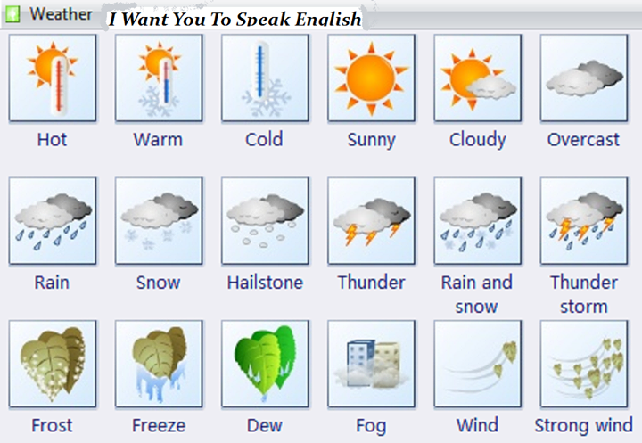
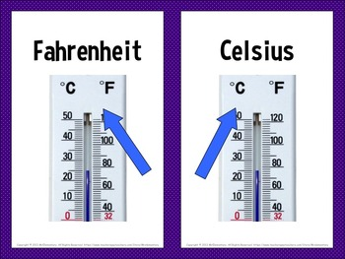

Slide 13
hot, degrees, Fahrenheit, Celsius, cold, below zero, cool, warm
Jeddah
It often falls below zero Celsius
Cherry blossoms
The leaves on the trees change color
warm tomorrow, about 86 degrees Fahrenheit, 30 degrees Celsius

Slide 14
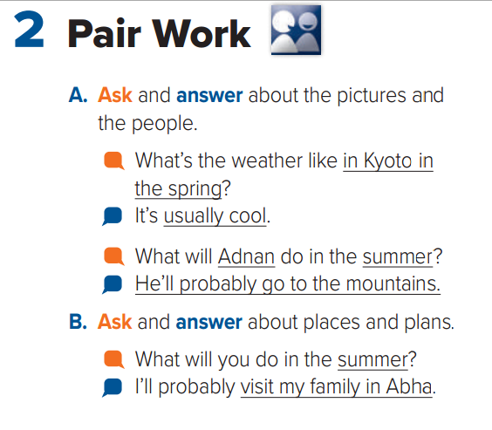

Slide 15
https://learningapps.org/watch?v=p5hm3hn5c21

Slide 16
WORKBOOK
P 107

Slide 17


